Slide 1
C++ Classes
C++ is about classes
A class is a building block, a self-contained entity providing public data fields (properties) and public operations (methods) for manipulating the class.
From the developer’s stand-point a class may contain private data and private methods to be used internally.

Slide 2
Advantages of Classes
Abstraction: classes make difficult tasks look simple by hiding unnecessary detail from user.
Example: a car is an abstract concept
(motor and electronics are hidden beneath the hood)
Polymorphism: different classes can share programming interface, which allows programmer to use different classes interchangeably but with different effect.
Example: shipping companies are “polymorphic”, it is sufficient to fill-out sender and recipient address to send a package with any company.
From user’s standpoint polymorphism provides interchangeability without the regard to internal differences (e.g. you can use a heat pump with your house’s air handler regardless of the heat pump being electric, gas or geothermal)
It is the developer’s responsibility to provide the internal details of polymorphic classes while adhering to the unified interface.

Slide 3
C++ Class Example
class MyClass
{
public:
MyClass(…); // constructors
~MyClass(); // destructor (optional)
public:
int MyProperty; // properties
public:
void MyMethod(…); // methods
private: // hidden under-the-hood
int InternalData; // details
void InternalMethod(…)
};

Slide 4
Objects
Object is an instance of a class.
Allocating an object on stack:
MyClass myClass(…);
class object
Allocating and object on heap:
MyClass* pMyClass = new MyClass(…);
To avoid memory leaks allocate your objects on stack wherever you can!
Accessing members:
myClass.MyMethod(…);
myClass.MyProperty = 1;
pMyClass->MyMethod(…);
pMyClass->MyProperty = 1;

Slide 5
What a Class Can Contain?
Constructors: called when an object is constructed on stack, allocated on heap using the new operator, or copied (copy-construction)
Destructors: called when a stack-allocated object goes out of scope or heap-allocated object is deleted using the delete operator.
Operators: some classes override +,-,=,<<,>>, etc. operators for convenience.
Do not override operators unless you are absolutely have to! There are very few cases (aside from mathematical objects) that warrant operator overloading.
Constant Fields: constant properties.
Superclass (base class): a subclass can be derived from a parent base class kind of like a child can be born from a parent; both a alike yet differ in some respects.
Virtual Members: base class members that are meant to be overloaded (i.e. replaced) in a subclass.
Protected Members: private members that can be accessed from the subclass’ code.
Abstract Methods (Pure Virtual Methods): methods that totally lack implementation.

Slide 6
Const Methods
Const Methods do not modify the object’s internal state (and thus cannot call non-const methods internally):
class MyClass
{
public:
MyClass(…);
public:
void MyMethod(…) const;
};
Always define a method as const if it does not modify the object’s internal data.

Slide 7
Static Members
A class can contain static data members and static methods
class MyClass
{
public:
MyClass(…);
public:
static int MyProperty;
static int MyStaticProperty;
static MyStaticMethod(…); // Can reference MyStaticProperty but cannot MyProperty
};
Static methods are global in the sense that they do not apply to an instance but apply to the class. Therefore static methods can reference only static data members of the class and cannot reference instance properties.
// Invocation example
MyClass::MyStaticMethod();

Slide 8
Parameter Passing
Pass parameters as const reference:
class MyClass
{
public:
MyClass(…);
public:
void MyMethod(const SomeOtherType&);
};
Passing parameter by reference eliminates copy-constructor overhead: if an object is passed by value a copy of the object is constructed on stack.

Slide 9
Constructors
Define as many constructors as necessary.
Constructors should match ways to initialize an object (and accept all necessary parameters for object initialization).
class DateTime
{
public:
DateTime(); // Default constructor, today’s date & time
DateTime(int year, int month, int day);
DateTime(int year, int month, int day,
int hour, int minute, int second);
};

Slide 10
Destructors
Only one destructor.
Destructor is needed if the class allocates resources (i.e. heap memory, files, OS handles, etc.) that need to be disposed / released when the class is destroyed.
Protected destructors: required subclasses to declare their own public destructors.
class MyClass
{
public:
MyClass();
~MyClass();
};

Slide 11
Base Classes, Inheritance
To specialize a generic class one can derive his one class from the generic base class.
Virtual methods provide such ‘specialization points’.
class MyBaseClass
{
public:
MyBaseClass();
virtual void MyVirtualMethod();
};
class MyDerivedClass: public MyBaseClass
{
public:
MyDerivedClass();
virtual void MyVirtualMethod(); // overrides MyBaseClass::MyVirtualMethod
};
In order to override a virtual method its signature in the derived class must match exactly the base class method.
Derived class can contain new members.
Derived class can access public and protected members of its base class(es).

Slide 12
Abstract Classes, Pure Virtual
When you define a base class but cannot prove the default implementation for one or more virtual methods you should declare such methods as pure virtual:
class MyBaseClass
{
public:
MyBaseClass();
virtual void MyVirtualMethod() = 0;
};
Classes containing pure virtual methods are called abstract. Abstract classes cannot be instantiated and thus must serve as base classes only.

Slide 13
Interfaces
Interfaces can be viewed as pure “abstract classes” in the sense that they support member declarations only and does not allow any method implementations.
Interfaces are not a standard feature in C++, yet existing programming paradigms require their support, hence Microsoft’s __interface extension:
__interface MyInterface
{
void MyMethod();
};
*Interfaces define only public members!
*Interfaces cannot contain constructors, destructors or data members, but can inherit from one or more base interface.

Slide 14
General Guidelines
Separate class declaration from implementation.
Put class declaration in .h file, implementation in .cpp file.
Keep your class structure rigid.
Inline small methods only.
Do not provide get/set accessors for trivial read/write properties.
Keep one large class per header file.
It is OK to group a bunch of small related classes in a single .h and .cpp pair if your project deals with a large number of classes.

Slide 15
General Guidelines
Separate class declaration from implementation.
Put class declaration in .h file, implementation in .cpp file.
Keep your class structure rigid.
Inline small methods only.
Do not provide get/set accessors for trivial read/write properties.
Keep one large class per header file.
It is OK to group a bunch of small related classes in a single .h and .cpp pair if your project deals with a large number of classes.

Slide 16
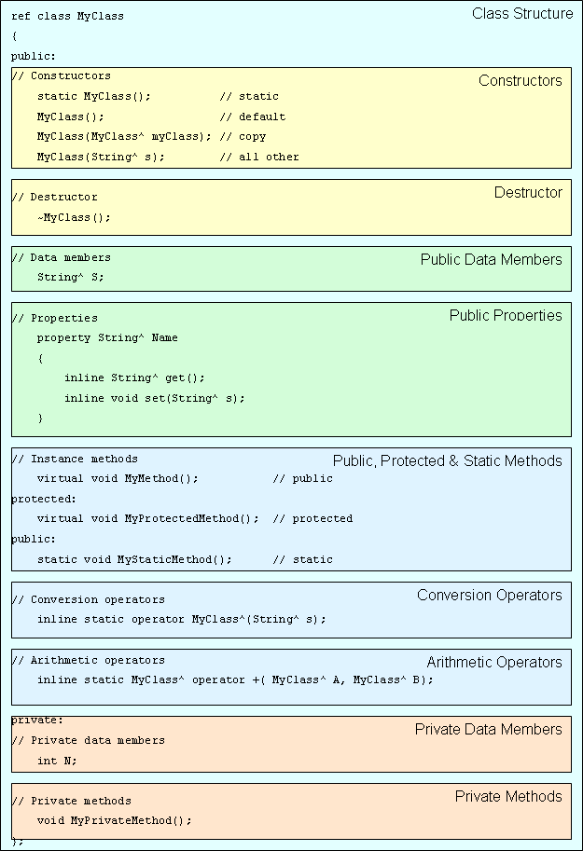
Class Structure Example

Slide 17
Operators
C++ allows overriding operators such as +, -, <, >, <<, >> that can serve special purpose:
class MyClass
{
public:
MyClass();
public:
bool operator == (const MyClass&) const;
MyClass operator + (const MyClass&) const;
};
From developers stand point operators are methods with a specific name that accept specific parameters.
C++ supports stand-alone operators that are not members of any class, e.g.
MyClass operator + (const MyClass& a, const MyClass& b);
As a general rule you should NOT overload operators unless developing a math-related class. Operators are NOT intuitive and although they are cool understanding operator-rich program is difficult.

